Slide 1
Midterm #2

Slide 2
Midterm 2
The idea is to create a web-based Antivirus application that allows the users to upload a file (of any type) to check if it contains malicious content. That is, if it is a Malware or not.
Definitions:
Infected File: It is a File that contains a Virus.
Putative Infected File: It is a File that might contain the Virus and needs to go under analysis.

Slide 3
Midterm 2
You will have to:
Build a web page that:
Ensures a secure Session mechanism.
Allows the user to submit a putative infected file and shows if it is infected or not.
Lets authenticate an Admin and allows him/her to submit a Malware file, plus the name of the uploaded Malware.
When an Admin adds the name of a malware during the uploading of a Malware file, it ensures that the string contains only English letters (capitalized or not) and digits. Any other character, or an empty string, must be avoided.

Slide 4
Midterm 2
Build a web application that:
Reads the file in input, per bytes, and, if it is Malware, stores the sequence of bytes, say, the first 20 bytes (signature) of the file, in a database (Note: only an Admin can upload a Malware file)
Keep in mind that, based on the type of file, the first 20 Bytes might not be very informative. In fact, they are usually used by the header (basically saying which kind of file it is). If you want to improve your application, you can add a dynamic mechanism that jumps the header and reads only the bytes after it.
Reads the file in input, per bytes, and, if it is a putative infected file, searches within the file for one of the strings stored in the database (Note: a normal user will always upload putative infected files).

Slide 5
Midterm 2
Build a MySQL database that:
Stores the information regarding the infected files in input, such as name of the malware (not the name of the file) and the sequence of bytes
Stores the information related to the Admin with username and password, in the most secure way of your knowledge.

Slide 6
Field Type
---------------------------------------------------------------
Author VARCHAR(128)
Title VARCHAR(128)
Type VARCHAR(16)
Year CHAR(4)
Notes:
Up to this moment we have this table in the database

Slide 7
Renaming a table
Renaming a table, like any other change to the structure or meta information about a table, is achieved via the ALTER command.
So, for example, to change the name of table classics to pre1900, use the following command:
ALTER TABLE classics RENAME pre1900;
Notes:
If you tried that command, you should revert the table name by entering the following:
ALTER TABLE pre1900 RENAME classics;

Slide 8
Changing the data type of a column
Changing a column’s data type also makes use of the ALTER command, this time in conjunction with the MODIFY keyword.
So to change the data type of column year from CHAR(4) to SMALLINT (which requires only 2 bytes of storage and so will save disk space), enter the following:
ALTER TABLE classics MODIFY year SMALLINT;
When you do this, if the conversion of data type makes sense to MySQL, it will automatically change the data while keeping the meaning.
In this case, it will change each string to a comparable integer, and so on, as the string is recognizable as referring to an integer.

Slide 9
Adding a new column
Here’s how to add the new column pages, which will be used to store the number of pages in a publication:
ALTER TABLE classics ADD pages SMALLINT UNSIGNED;
This adds the new column with the name pages using the UNSIGNED SMALLINT data type, sufficient to hold a value of up to 65,535
Note: Because the table contains already several entries, the values for the field pages will all be NULL

Slide 10
Field Type
---------------------------------------------------------------
Author VARCHAR(128)
Title VARCHAR(128)
Type VARCHAR(16)
Year SMALLINT
Pages SMALLINT UNSIGNED

Slide 11
Renaming a column
Let’s rename type column name to category, like this:
ALTER TABLE classics CHANGE type category VARCHAR(16);
Note the addition of VARCHAR(16) on the end of this command.
That’s because the CHANGE keyword requires the data type to be specified, even if you don’t intend to change it, and VARCHAR(16) was the data type specified when that column was initially created as type.

Slide 12
Field Type
---------------------------------------------------------------
Author VARCHAR(128)
Title VARCHAR(128)
Category VARCHAR(16)
Year SMALLINT
Pages SMALLINT UNSIGNED

Slide 13
Removing a column
You might decide that the page count column pages isn’t actually all that useful for this particular database, so here’s how to remove that column by using the DROP keyword:
ALTER TABLE classics DROP pages;
Remember that DROP is irreversible and you should always use it with caution, because you could inadvertently delete entire tables (and even databases) with it if you are not careful!

Slide 14
Field Type
---------------------------------------------------------------
Author VARCHAR(128)
Title VARCHAR(128)
Category VARCHAR(16)
Year SMALLINT
Pages SMALLINT UNSIGNED

Slide 15
Deleting a table
Deleting a table is very easy indeed. But, because I don’t want you to have to reenter all the data for the classics table, let’s quickly create a new table, verify its existence and then delete it.
CREATE TABLE disposable(trash INT);
DESCRIBE disposable;
DROP TABLE disposable;
SHOW tables;

Slide 16
Indexes
The database accesses will get slower and slower with every new row added, because MySQL has to search through every row whenever a query is issued.
This is like searching through every book in a library whenever you need to look something up.
At the expense of a slight overhead in memory and disk space, you can create an index for a table that MySQL will use to conduct lightning-fast searches.

Slide 17
Creating an Index
There are different index types such as a regular INDEX, PRIMARY KEY, and FULLTEXT.
Also, you must decide which columns require an index, a judgment that requires you to predict whether you will be searching any of the data in that column.
Indexes can also get complicated, because you can combine multiple columns in one index.
And even when you’ve decided that, you still have the option of reducing index size by limiting the amount of each column to be indexed.

Slide 18
Creating an Index
If we imagine the searches that may be made on the classics table, it becomes apparent that all of the columns may need to be searched.
However, the pages column doesn’t need an index, as most people would be unlikely to search for books by the number of pages they have.
Anyway, go ahead and add an index to each of the columns, using the commands:
ALTER TABLE classics ADD INDEX(author(20));
ALTER TABLE classics ADD INDEX(title(20));
ALTER TABLE classics ADD INDEX(category(4));
ALTER TABLE classics ADD INDEX(year);
DESCRIBE classics;
Note that the pages column doesn’t need an index

Slide 19
The first two commands create indexes on both the author and title columns, limiting each index to only the first 20 characters.
For instance, when MySQL indexes the following title: The Adventures of Tom Sawyer
It will actually store in the index only the first 20 characters: The Adventures of To
This is done to minimize the size of the index, and to optimize database access speed.
I chose 20 because it’s likely to be sufficient to ensure uniqueness for most strings in these columns.
ALTER TABLE classics ADD INDEX(author(20));
ALTER TABLE classics ADD INDEX(title(20));
ALTER TABLE classics ADD INDEX(category(4));
ALTER TABLE classics ADD INDEX(year);
DESCRIBE classics;
Notes:
If MySQL finds two indexes with the same contents, it will have to waste time going to the table itself and checking the column that was indexed to find out which rows really matched.

Slide 20
With the category column, currently only the first character is required to identify a string as unique (F for Fiction, N for Nonfiction, and P for Play)
So why 4?
I chose an index of 4 characters to allow for future category types that may be unique only after four characters.
You can also re-index this column later, when you have a more complete set of categories.
And finally, I set no limit to the year column’s index, because it’s an integer, not a string.
ALTER TABLE classics ADD INDEX(author(20));
ALTER TABLE classics ADD INDEX(title(20));
ALTER TABLE classics ADD INDEX(category(4));
ALTER TABLE classics ADD INDEX(year);
DESCRIBE classics;

Slide 21
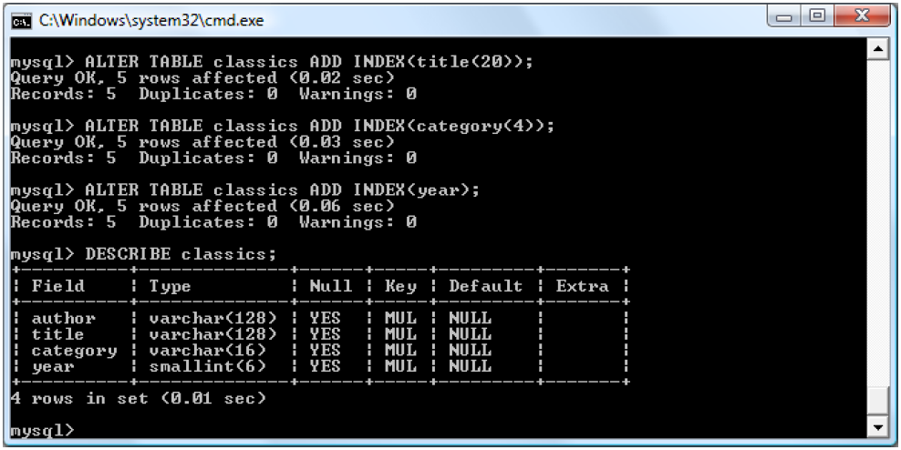
The key MUL for each column means that multiple occurrences of a value may occur within that column, which is exactly what we want, as authors may appear many times, the same book title could be used by multiple authors, and so on.

Slide 22
Using CREATE INDEX
An alternative to using ALTER TABLE to add an index is to use the CREATE INDEX command.
These two commands are equivalent:
ALTER TABLE classics ADD INDEX(author(20));
CREATE INDEX author ON classics (author(20));
Except that CREATE INDEX cannot be used for creating a PRIMARY KEY.

Slide 23
Adding indexes when creating tables
You don’t have to wait until after creating a table to add indexes. In fact, doing so can be time-consuming, as adding an index to a large table can take a very long time.
CREATE TABLE classics (
author VARCHAR(128),
title VARCHAR(128),
category VARCHAR(16),
year SMALLINT,
INDEX(author(20)),
INDEX(title(20)),
INDEX(category(4)),
INDEX(year)
) ENGINE InnoDB;
Notes:
You can mix the INDEX with the field creation

Slide 24
Primary keys
Now all the publications in the table can be searched, but there is no single unique key for each publication to enable instant accessing of a row.
So let’s create a new column as a key. We’ll use the ISBNs that are 13 characters long, so a line like this would do the job:
ALTER TABLE classics ADD isbn CHAR(13) PRIMARY KEY;
But it doesn’t work… If you try it, you’ll get the error Duplicate entry for key 1
The reason is that the table is already populated with some data and this command is trying to add a column with the value NULL to each row, which is not allowed, as all values must be unique in any column having a primary key index.
However, if there were no data already in the table, this command would work just fine, as would adding the primary key index upon table creation.
Notes:
You are trying to add a column, so all the “primary key” fields of the records are all NULL and so not unique!
The importance of having a key with a unique value for each row will come up when we start to combine data from different tables.

Slide 25
Primary keys
Luckily, each of the years is unique in the current set of data, so we can use the year column to identify each row:
ALTER TABLE classics ADD isbn CHAR(13);
UPDATE classics SET isbn='9781598184891' WHERE year='1876';
UPDATE classics SET isbn='9780582506206' WHERE year='1811';
UPDATE classics SET isbn='9780517123201' WHERE year='1856';
UPDATE classics SET isbn='9780099533474' WHERE year='1841';
UPDATE classics SET isbn='9780192814968' WHERE year='1594’;
ALTER TABLE classics ADD PRIMARY KEY(isbn);
DESCRIBE classics;
No Primary Key yet

Slide 26
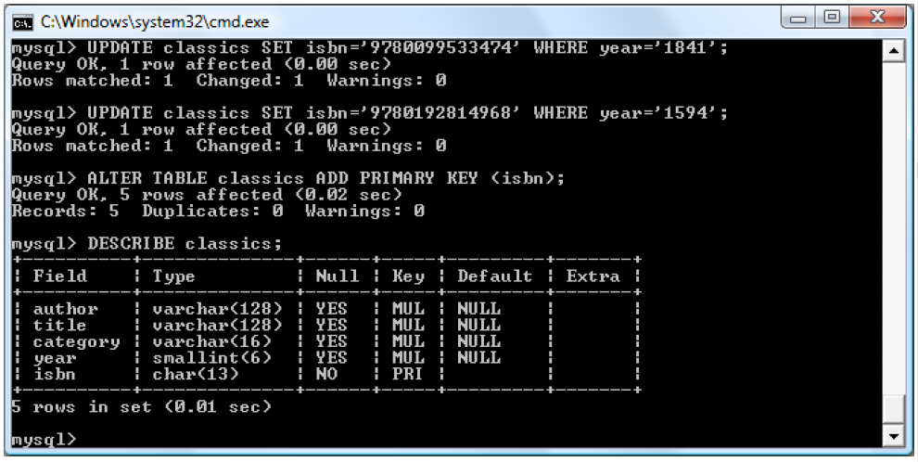
Note the PRI instead of MUL

Slide 27
Primary keys
To have created a primary key when the table classics was created, you could have used these commands:
CREATE TABLE classics (
author VARCHAR(128),
title VARCHAR(128),
category VARCHAR(16),
year SMALLINT,
isbn CHAR(13),
INDEX(author(20)),
INDEX(title(20)),
INDEX(category(4)),
INDEX(year),
PRIMARY KEY (isbn)
) ENGINE MyISAM;

Slide 28
Creating a FULLTEXT index
Unlike a regular index, MySQL’s FULLTEXT allows super-fast searches of entire columns of text.
It stores every word in every data string in a special index that you can search using “natural language,” in a similar manner to using a search engine.
It’s not strictly true that MySQL stores all the words in a FULLTEXT index, because it has a built-in list of more than 500 words that it chooses to ignore because they are so common that they aren’t very helpful for searching anyway.
This list, called stopwords, includes the, as, is, of, and so on.
The list helps MySQL run much more quickly when performing a FULLTEXT search and keeps database sizes down.

Slide 29
Here are some things that you should know about FULLTEXT indexes:
FULLTEXT indexes can be used only with some engines (like, MyISAM and InnoDB). If you need to convert a table to a different engine, you can usually use the MySQL command:
ALTER TABLE tablename ENGINE = InnoDB;
FULLTEXT indexes can be created for CHAR, VARCHAR, and TEXT columns only
A FULLTEXT index definition can be given in the CREATE TABLE statement when a table is created, or added later using ALTER TABLE (or CREATE INDEX)
For large data sets, it is much faster to load your data into a table that has no FULLTEXT index and then create the index than to load data into a table that has an existing FULLTEXT index.

Slide 30
Creating a FULLTEXT index
Adding a FULLTEXT index to the table classics:
ALTER TABLE classics ADD FULLTEXT(author,title);
You can now perform FULLTEXT searches across this pair of columns.
This feature could really come into its own if you could now add the entire text of these publications to the database (particularly as they’re out of copyright protection) and they would be fully searchable.
Notes:
With it, you can make natural-language searches as you would in an Internet search engine.

Slide 31
Querying a MySQL Database
So far, we’ve created a MySQL database and tables, populated them with data, and added indexes to make them fast to search. Now it’s time to look at how these searches are performed, and the various commands and qualifiers available.
Let’s examine of the command, SELECT, in more detail.
SELECT something FROM tablename;
The something can be an * (asterisk), which means every column, or you can choose to select only certain columns.
SELECT author,title FROM classics;
SELECT title,isbn FROM classics;

Slide 32
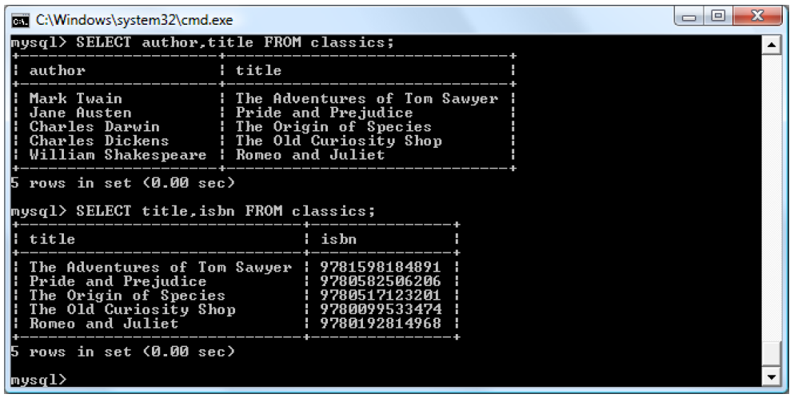

Slide 33
Querying a MySQL Database
Another replacement for the something parameter is COUNT, which can be used in many ways.
Here, it displays the number of rows in the table by passing * as a parameter, which means all rows.
SELECT COUNT(*) FROM classics;
As you’d expect, the result returned is 5, as there are five publications in the table.

Slide 34
Querying a MySQL Database
SELECT DISTINCT qualifier (and its synonym DISTINCTROW) allows you to weed out multiple entries when they contain the same data.
For instance, suppose that you want a list of all authors in the table.
If you select just the author column from a table containing multiple books by the same author, you’ll normally see a long list with the same author names over and over.
But by adding the DISTINCT keyword, you can show each author just once.

Slide 35
Querying a MySQL Database
So let’s test that out by adding another row that repeats one of our existing authors
INSERT INTO classics(author, title, category, year, isbn)
VALUES('Charles Dickens','Little Dorrit','Fiction','1857', '9780141439969’);
Now that Charles Dickens appears twice in the table, we can compare the results of using SELECT with and without the DISTINCT qualifier.
SELECT author FROM classics;
SELECT DISTINCT author FROM classics;

Slide 36
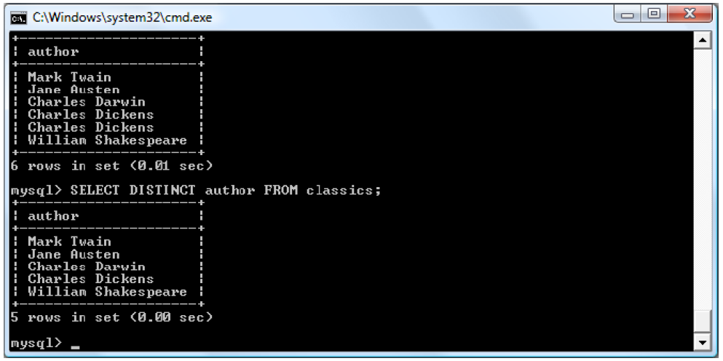

Slide 37
Querying a MySQL Database
When you need to remove a row from a table, use the DELETE command.
Its syntax is similar to the SELECT command and allows you to narrow down the exact row or rows to delete using qualifiers such as WHERE and LIMIT.
DELETE FROM classics WHERE title='Little Dorrit’;
This example issues a DELETE command for all rows whose title column contains the string Little Dorrit.
The WHERE keyword is very powerful, and important to enter correctly; an error could lead a command to the wrong rows (or have no effect in cases where nothing matches the WHERE clause).

Slide 38
Querying a MySQL Database
The WHERE keyword enables you to narrow down queries by returning only those where a certain expression is true.
SELECT author,title FROM classics WHERE author="Mark Twain";
SELECT author,title FROM classics WHERE isbn="9781598184891 ";
Given our current table, the two commands display the same results.
But we could easily add more books by Mark Twain, in which case the first line would display all titles he wrote and the second line would continue (because we know the ISBN is unique) to display The Adventures of Tom Sawyer.
In other words, searches using a unique key are more predictable, and you’ll see further evidence later of the value of unique and primary keys.

Slide 39
Querying a MySQL Database
You can also do pattern matching for your searches using the LIKE qualifier, which allows searches on parts of strings.
This qualifier should be used with a % character before or after some text.
When placed before a keyword, % means anything before.
After a keyword, it means anything after.

Slide 40
SELECT author,title FROM classics WHERE author LIKE "Charles%";
SELECT author,title FROM classics WHERE title LIKE "%Species";
SELECT author,title FROM classics WHERE title LIKE "%and%";
The first command outputs the publications by both Charles Darwin and Charles Dickens because the LIKE qualifier was set to return anything matching the string Charles followed by any other text.
Then just The Origin of Species is returned, because it’s the only row whose column ends with the string Species.
Last, both Pride and Prejudice and Romeo and Juliet are returned, because they both matched the string and anywhere in the column.
The % will also match if there is nothing in the position it occupies; in other words, it can match an empty string.

Slide 41
Querying a MySQL Database
The LIMIT qualifier enables you to choose how many rows to return in a query, and where in the table to start returning them.
When passed a single parameter, it tells MySQL to start at the beginning of the results and just return the number of rows given in that parameter.
If you pass it two parameters, the first indicates the offset from the start of the results where MySQL should start the display, and the second indicates how many to return.
SELECT author,title FROM classics LIMIT 3;
SELECT author,title FROM classics LIMIT 1,3;
SELECT author,title FROM classics LIMIT 3,1;
Be careful with the LIMIT keyword, because offsets start at 0, but the number of rows to return starts at 1. So LIMIT 1,3 means return three rows starting from the second row.
Notes:
The first returns the first three rows from the table.
The second returns 3 rows starting at position 1 (skipping the first row).
The last command returns a single row starting at position 3 (skipping the first three rows).
You can think of the first parameter as saying, “Skip this number of results at the start.”

Slide 42
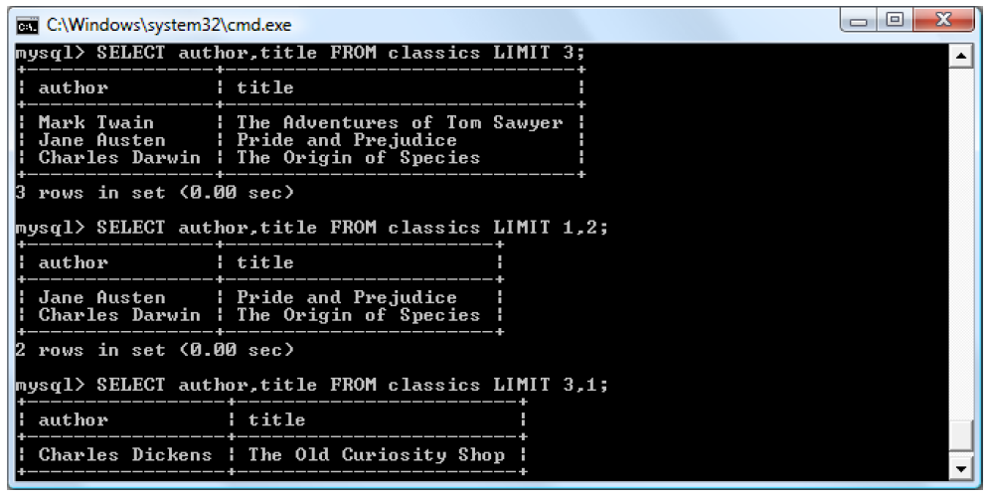

Slide 43
Querying a MySQL Database
The MATCH...AGAINST construct can be used on columns that have been given a FULLTEXT index
Unlike the use of WHERE...= or WHERE...LIKE, MATCH...AGAINST lets you enter multiple words in a search query and checks them against all words in the FULLTEXT columns.
FULLTEXT indexes are case-insensitive, so it makes no difference what case is used in your queries.

Slide 44
Querying a MySQL Database
For example, Assuming that you have added a FULLTEXT index to the author and title columns, enter these 3 queries:
SELECT author,title FROM classics
WHERE MATCH(author,title) AGAINST('and');
It asks for any of these columns that contain the word and to be returned.
Because and is a stopword, MySQL will ignore it and the query will always produce an empty set—no matter what is stored in the columns.

Slide 45
Querying a MySQL Database
SELECT author,title FROM classics
WHERE MATCH(author,title) AGAINST('curiosity shop');
This second query asks for any rows that contain both of the words curiosity and shop anywhere in them, in any order, to be returned.
SELECT author,title FROM classics
WHERE MATCH(author,title) AGAINST('tom sawyer’);
And the last query applies the same kind of search for the words tom and sawyer.

Slide 46
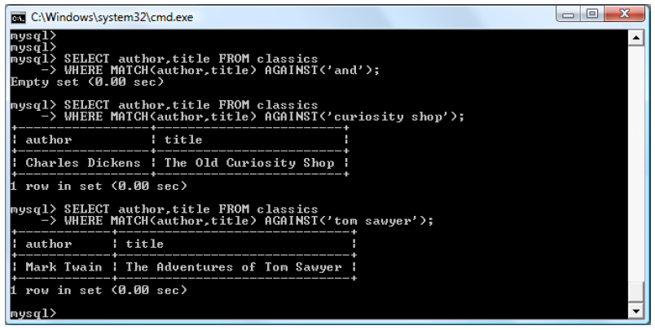

Slide 47
Querying a MySQL Database
If you wish to give your MATCH...AGAINST queries even more power, use Boolean mode.
It now searches for any combination of search words, instead of requiring all search words to be in the text.
The presence of a single word in a column causes the search to return the row.
Boolean mode also allows you to preface search words with a + or - sign to indicate whether they must be included or excluded.
SELECT author,title FROM classics
WHERE MATCH(author,title)
AGAINST('+charles -species' IN BOOLEAN MODE);
SELECT author,title FROM classics
WHERE MATCH(author,title)
AGAINST('"origin of"' IN BOOLEAN MODE);
NOTE: The stopword of is part of the search string, but is still used by the search because the double quotation marks override stopwords.
Notes:
If normal Boolean mode says, “Any of these words will do,” a plus sign means, “This word must be present; otherwise, don’t return the row.” A minus sign means, “This word must not be present; its presence disqualifies the row from being returned.”
The first asks for all rows containing the word charles and not the word species to be returned. The second uses double quotes to request that all rows containing the exact phrase origin of be returned.

Slide 48
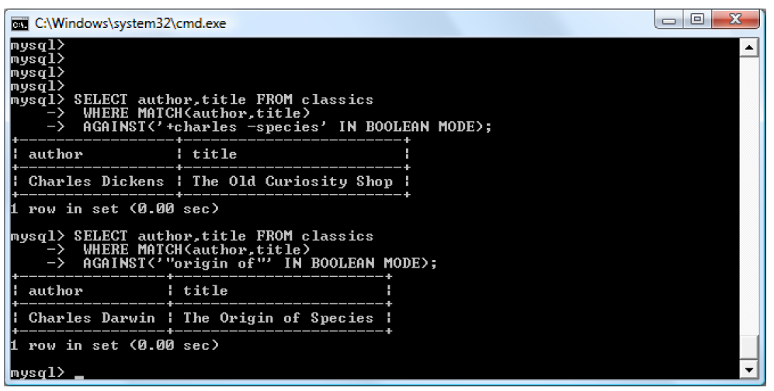

Slide 49
Querying a MySQL Database
You can use UPDATE…SET if you want to change the contents of one or more fields, you need to first narrow in on just the field or fields to be changed, in much the same way you use the SELECT command.
UPDATE classics SET author='Mark Twain (Samuel Langhorne Clemens)’
WHERE author='Mark Twain’;
UPDATE classics SET category='Classic Fiction’
WHERE category='Fiction’;
In the first query, Mark Twain’s real name of Samuel Langhorne Clemens was appended to his pen name in brackets, which affected only one row.
The second query, however, affected three rows, because it changed all occurrences of the word Fiction in the category column to the term Classic Fiction.
Notes:
When performing an update, you can also make use of the qualifiers you have already seen, such as LIMIT, and the following ORDER BY and GROUP BY keywords.

Slide 50
Querying a MySQL Database
ORDER BY sorts returned results by one or more columns in ascending or descending order.
SELECT author,title FROM classics ORDER BY author;
SELECT author,title FROM classics ORDER BY title DESC;
As you can see, the first query returns the publications by author in ascending alphabetical order (the default), and the second returns them by title in descending order.

Slide 51
Querying a MySQL Database
If you wanted to sort all the rows by author and then by descending year of publication (to view the most recent first), you would issue the following query:
SELECT author, title, year FROM classics ORDER BY author, year DESC;
The DESC keyword applies only to the preceding column, year.
Because you allow author to use the default sort order, it is sorted in ascending order. You could also have explicitly specified ascending order for that column, with the same results:
SELECT author, title, year FROM classics ORDER BY author ASC, year DESC;

Slide 52
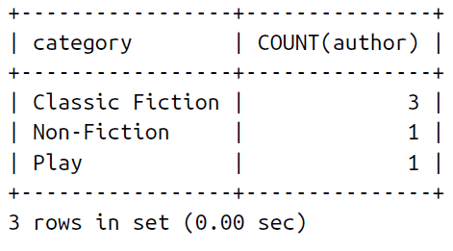
Querying a MySQL Database
In a similar fashion to ORDER BY, you can group results returned from queries using GROUP BY, which is good for retrieving information about a group of data.
SELECT category,COUNT(author) FROM classics GROUP BY category;
Notes:
If you want to know how many publications there are of each category in the classics table

Slide 53
Joining Tables Together
It is quite normal to maintain multiple tables within a database, each holding a different type of information.
For example, consider the case of a customers table that needs to be able to be cross-referenced with publications purchased from the classics table.

Slide 54
Creating and populating the customers table
CREATE TABLE customers (
name VARCHAR(128),
isbn VARCHAR(13),
PRIMARY KEY (isbn))
ENGINE MyISAM;
INSERT INTO customers(name,isbn)
VALUES('Joe Bloggs','9780099533474’);
INSERT INTO customers(name,isbn)
VALUES('Mary Smith','9780582506206’);
INSERT INTO customers(name,isbn)
VALUES('Jack Wilson','9780517123201’);
SELECT * FROM customers;
Better to use CHAR(13). In fact, CHAR is faster than VARCHAR and isbn cannot be less than 13 chars anyway…
There is an error though… varchar is slower than char(13)…

Slide 55
NOTE There’s also a shortcut for inserting multiple rows of data in which you can replace the three separate INSERT INTO queries with a single one listing the data to be inserted, separated by commas, like this:
INSERT INTO customers(name,isbn) VALUES
('Joe Bloggs','9780099533474’),
('Mary Smith','9780582506206’),
('Jack Wilson','9780517123201');

Slide 56
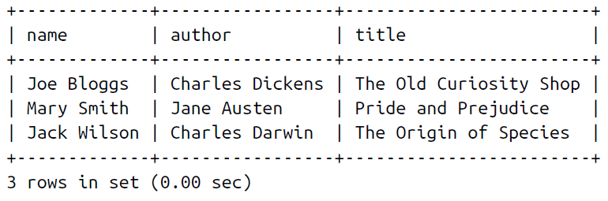
Joining two tables into a single SELECT
SELECT name,author,title from customers,classics
WHERE customers.isbn=classics.isbn;
The result of this operation is the following:

Slide 57
NATURAL JOIN
Using NATURAL JOIN, you can save yourself some typing and make queries a little clearer.
This kind of join takes two tables and automatically joins columns that have the same name
So, to achieve the same results you would enter the following:
SELECT name,author,title FROM customers NATURAL JOIN classics;

Slide 58
JOIN...ON
If you wish to specify the column on which to join two tables, use the JOIN...ON construct
SELECT name,author,title FROM customers
JOIN classics ON customers.isbn=classics.isbn;

Slide 59
Using AS
You can also save yourself some typing and improve query readability by creating aliases using the AS keyword.
Follow a table name with AS and the alias to use.
Aliases can be particularly useful when you have long queries that reference the same table names many times.
SELECT name,author,title from
customers AS cust, classics AS class WHERE cust.isbn=class.isbn;

Slide 60
Using Logical Operators
You can also use the logical operators AND, OR, and NOT in your MySQL WHERE queries to further narrow down your selections.
SELECT author,title FROM classics WHERE
author LIKE "Charles%" AND author LIKE "%Darwin";
SELECT author,title FROM classics WHERE
author LIKE "%Mark Twain%" OR author LIKE "%Samuel Langhorne Clemens%";
SELECT author,title FROM classics WHERE
author LIKE "Charles%" AND author NOT LIKE "%Darwin";
Notes:
I’ve chosen the first query, because Charles Darwin might be listed in some rows by his full name, Charles Robert Darwin. Thus, the query returns publications as long as the author column starts with Charles and ends with Darwin.
The second query searches for publications written using either Mark Twain’s pen name or his real name, Samuel Langhorne Clemens.
The third query returns publications written by authors with the first name Charles but not the surname Darwin.

Slide 61
MySQL Functions
Why anyone would want to use MySQL functions instead of PHP functions?
The MySQL functions work on the data right there in the database.
If you were to use PHP, you would first have to extract raw data from MySQL, manipulate it, and then perform the database query you first wanted.

Slide 62
MySQL Functions
Having functions built into MySQL substantially reduces the time needed for performing complex queries, as well as their complexity.
If you wish to learn more about the available string and date/time functions, you can visit the following URLs:
https://dev.mysql.com/doc/refman/5.7/en/string-functions.html
https://dev.mysql.com/doc/refman/5.7/en/date-and-time-functions.html
Ex:
mysql> SELECT CONCAT('My', 'S', 'QL');
-> 'MySQL'

